Slide 1
US Elections 2016
~Team 1

Slide 2
Objective
Analyze the trends and predictions (Building predictive models using various Machine-Leaning algorithms) of Democratic and Republican Primaries Results.
Social Network (Twitter) Analysis of 2016 US Presidential Election Candidates

Slide 3
Data Preprocessing
Removing the incomplete/ incorrect data for the states
Giving meaningful names to the variables
Calculating state wise total votes and fraction votes
Merging the different CSV files
Data Preprocessing was done on AzureML using the “Execute Python” module

Slide 4
Exploratory analysis
The Exploratory Analysis was done on Power BI which is embedded on to our website

Slide 5
Building Predictive Models for Democrat Candidates
Predictive Model for Hillary Clinton | Bayesian Linear Regression | Random Forest | XGBoost Regression | Logistic Regression
Test RMSE | 0.07 | 0.092 | 0.03 | 0.10
Predictive Model for Bernie Sanders | Bayesian Linear Regression | Random Forest | XGBoost Regression | Logistic Regression
Test RMSE | 0.042 | 0.04 | 0.037 | 0.05

Slide 6
Building Predictive Models for Republican Candidates
Predictive Model for Ted Cruz | Bayesian Linear Regression | Random Forest | XGBoost Regression | Logistic Regression
Test RMSE | 0.157 | 0.21 | 0.151 | 0.156
Predictive Model for Donald Trump | Bayesian Linear Regression | Random Forest | XGBoost Regression | Logistic Regression
Test RMSE | 0.18 | 0.20 | 0.153 | 0.16

Slide 7
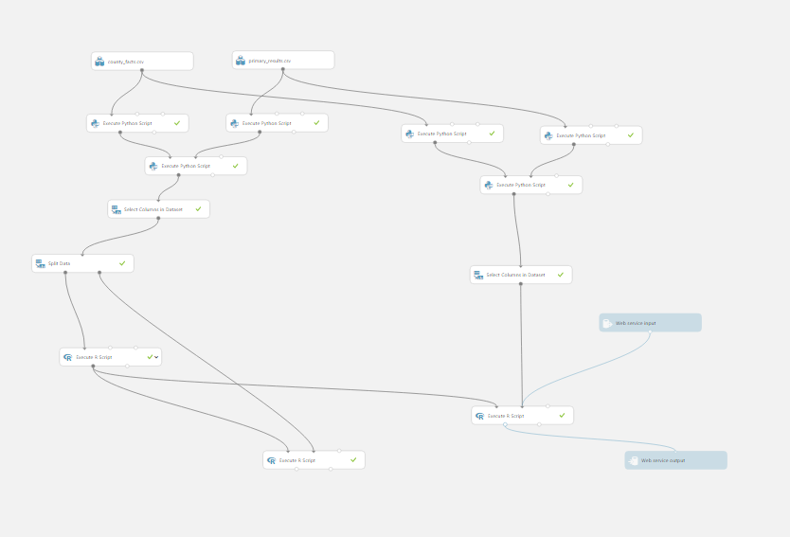
Pipeline for Hillary Clinton

Slide 8
Real-time Twitter sentiment analysis in Azure Stream Analytics
The objective is to analyze public sentiment for 2 of the presidential candidates in the ongoing 2016 U.S. election namely, Donald Trump & Hillary Clinton, as expressed on Twitter, a micro-blogging service.
Requirements: Twitter account and OAuth access token, TwitterClient.zip from the Microsoft Download Center, Work or school account for Power BI

Slide 9
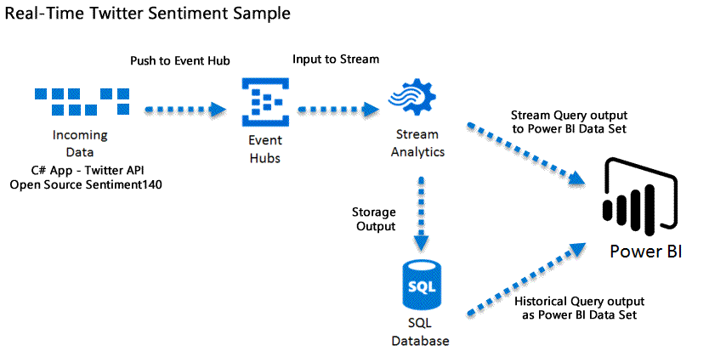
Workflow

Slide 10
Demo

